Slide 1
Scaler B2G Expansion | Should We Enter?
A Strategic & Financial Assessment for the CEO April 2026 | Confidential

Slide 2
Scaler should enter B2G now — the PSU & Central Govt tech-skilling window is open
Context
Scaler has built India's most credible tech-outcomes engine — 93% placement, ₹10+ LPA median salary, curriculum that mirrors what FAANG and PSU IT teams hire for.
The Shift
B2C growth compresses as ed-tech consolidates. The ₹8,650 Cr government skilling market is pivoting from volume headcounts to outcome-linked tech programs — validated by CAG audits, ₹38,746 Cr budget allocation, and PMKVY 5.0 redesign.
The Question
Should Scaler enter B2G — and if so, which segment, what business model, and what financial return justifies the investment and distraction cost?
Our Answer
Enter B2G. Target PSU upskilling + Central Govt digital programs. Skip mass vocational. ₹93 Cr revenue by FY30. EBITDA positive FY27. ₹360 Cr enterprise value at median ed-tech multiples.
Decision ask: Approve ₹3.5 Cr seed investment and an 11-person B2G team. Gate at Month 12: 3 signed contracts = proceed to scale; else pivot.
Source: CAG Report No. 20/2025; MSDE; MeitY/PIB; IndiaAI Mission; Careers360; The Federal; IndiaSpend; Bodhi analysis;

Slide 3
India's ₹8,650 Cr govt skilling market is real — and 2026 has broken it wide open
Why 2026 is different
PMKVY 5.0 shifts to skill
outcome bonds & vouchers
First time govt pays for placement, not headcount
Mission Karmayogi + Coursera
(signed March 2026)
7.5M civil servants; iGOT marketplace now open to private content
NITI Aayog CEO (May 2025):
'Hand skilling to private sector'
₹38,746 Cr
₹10,372 Cr
+14% CAGR
Political cover for outcome-led private partnership at scale
Labour & Skill Budget
FY26 (+80% YoY)
IndiaAI Mission
5-yr outlay (Mar 2024)
Govt Skilling Spend
FY22 → FY26
L1 procurement reform
(Oct 2024)
Quality-cum-cost-based selection now permitted on tech tenders
Source: MSDE Budget FY26; MeitY; IndiaAI Mission PIB; DPE; Bodhi analysis;

Slide 4
₹14,450 Cr spent, <20% placed — the B2G graveyard reveals exactly the white space
Scaler = 4.6x best PMKVY rate
The Federal | December 2025
"Skill India exposed as a non-starter in CAG audit of Rs 10,000-cr spend. 94.53% of beneficiary bank accounts contained zeros, null, N/A or blank."
— The Federal, Dec 18 2025
Careers360 | March 2026
"PMKVY 4.0 was 'delinked' from placements after versions 1.0–3.0 showed outrageously poor figures. When asked why, the CPIO called the question 'hypothetical'."
IL&FS Skills
NIIT Yuva Jyoti
NSDC CEO Fired
— Careers360 / Bommai Committee Report, Mar 28 2025
Trained 1.5M people. Collapsed Sep 2018 inside ₹61,000 Cr parent default. Rebranded as Learnet Skills. B2G ambition wound down.
NSDC JV for PMKVY 1.0. Now limited to CSR/MoRD projects. Never built a ₹100 Cr government book.
CEO terminated May 2025 amid ₹1,082 Cr forensic audit irregularities. 178 training partners blacklisted for fake trainees.
The Wire | Feb 2025 — Santosh Mehrotra, IZA Institute
"The government is prioritising quick certifications over substantive skill development — producing more 'certified individuals' without real competencies."
— The Wire, Feb 2025
The insight: Every failure was a failure of the volume-paid model — not proof that B2G can't work. The graveyard is Scaler's competitive moat: it guarantees there is no experienced incumbent to beat.
Source: CAG Report No. 20/2025; The Federal Dec 2025; IndiaSpend; IDR; NSDC forensic audit; Bodhi analysis;

Slide 5
Devil's advocate: five hard questions the CEO must answer before writing the cheque
Scaler's govt revenue is ₹0 today. Why should anyone bet ₹3.5 Cr on this?
Zero revenue means zero path dependency — no bad contracts to unwind, no L1 habits to break. The only prior B2G touch is an eGov Foundation GovTech course at SST, validating curriculum fit without commercial risk. Starting clean is a structural advantage vs. NIIT's 20-year-old playbook.
1
2
PMKVY 3.0 placed only 10%. Why would outcome-based contracting ever actually happen?
PMKVY 4.0 explicitly delinked placements to avoid embarrassment. PMKVY 5.0 design docs (Careers360, Mar 2026) mandate 'skill outcome bonds' and 'post-training outcome tracking for 1 year'. The parliamentary Bommai Committee demanded placements as 'the real barometer'. The regulator has publicly admitted the old model failed — it is redesigning around Scaler's metric.
3
IAS officers get $35K–$45K/year for Harvard. Why would govt pay $40K for a Scaler cohort?
This is actually the argument FOR Scaler, not against it. The Domestic Funding of Foreign Training scheme ($35–45K/officer/year for Top-30 universities) proves govt will pay premium for quality when the outcome matters. Mission Karmayogi just contracted Coursera for 7.5M civil servants — at a platform subscription fee. The taboo on premium pricing in B2G is broken.
4
If the premium tier is open, why isn't TCS iON or Coursera already dominant?
TCS iON's est. ₹900 Cr govt book is exam infrastructure and LMS — not outcome-led tech upskilling. Coursera entered iGOT only in March 2026. Simplilearn has content but no placement proof. The premium tech-outcomes sub-segment (₹1,500–2,000 Cr addressable) has zero credentialed incumbent. The window is genuinely open.
5
Scaler's curriculum costs ₹3L+ for B2C. Will it survive L1 government procurement?
PSU contracts are not L1 — they are enterprise procurement like any corporate client. BSNL, SBI, NTPC tender for tech training through direct vendor evaluation, not GeM. The Oct 2024 procurement reform also extended QCBS for tenders up to ₹10 Cr. Strategy: price PSU deals like enterprise B2B (₹40K/employee), avoid PMKVY mass-volume tenders entirely in Year 1.
Verdict: Each question has a real, evidenced answer. The risk is not whether the thesis holds — it is whether Scaler moves fast enough before the window closes.
Source: PMKVY 4.0 guidelines; DoPT DFFT scheme; CAG; Bodhi analysis;

Slide 6
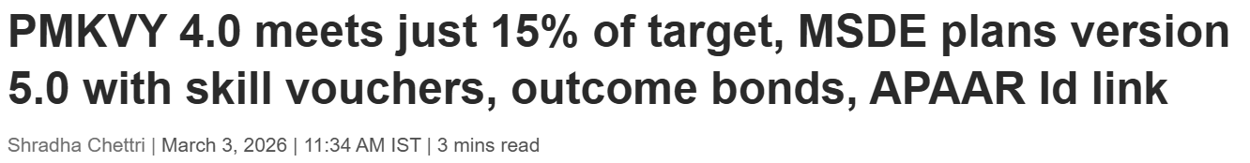
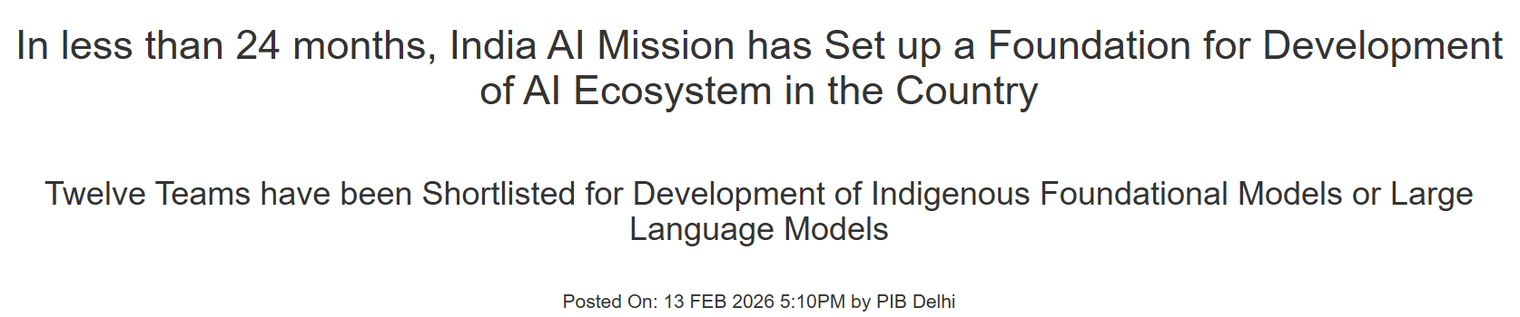
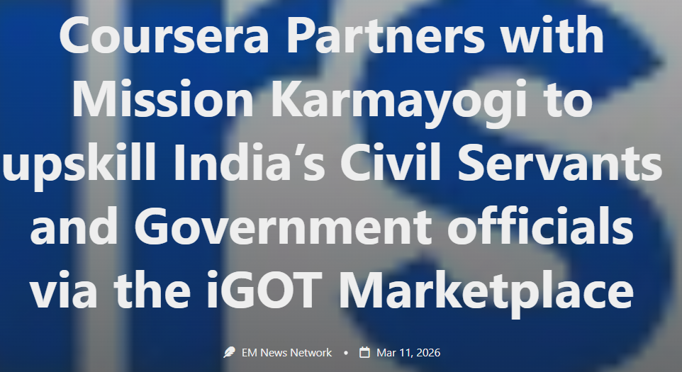
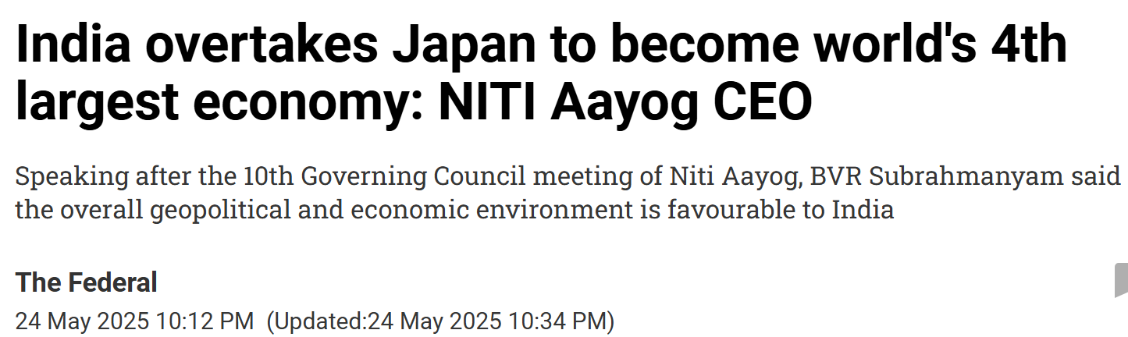
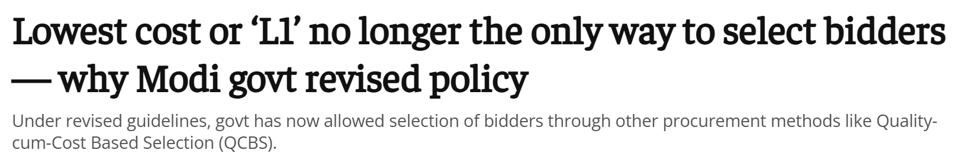
Five structural breaks make India's 2026 B2G market unrecognisable from what failed
PMKVY 5.0
First time in PMKVY history payment will be linked to placement. 'Post-training outcome tracking for 1 year' + APAAR ID integration. Skill vouchers replace headcount-based funding.
Skill outcome bonds
Careers360, Mar 2026
IndiaAI Mission
Cabinet-approved Mar 2024. By Feb 2026: 38K GPUs, 12 foundation model consortia, 174 ITIs/polytechnics nominated. FutureSkills pillar funds AI curriculum supply through private partnerships.
₹10,372 Cr; 543 AI Labs
PIB Feb 2026
Mission Karmayogi
+ Coursera
March 2026: Coursera contracts with Karmayogi Bharat for AI for Leaders, Data Analytics, Cybersecurity. Private content marketplace model validated at 7.5M seat scale.
7.5M civil servants; iGOT open
Education Matters, Mar 2026
NITI Aayog CEO
BVR Subrahmanyam, May 17 2025: suggests govt should hand over skilling institutions to private sector. 180° reversal from post-2016 centralised CSCM model. Top-of-govt political cover for PPPs.
'Hand skilling to private sector'
The Federal, May 2025
L1 Procurement Reform
GFR amended to permit Quality-cum-Cost Based Selection on complex IT/skilling tenders up to ₹10 Cr. Removes structural pricing impossibility for premium quality offerings on mid-size contracts.
Quality-cum-cost now allowed
The Print L1 reform Oct 2024
Source: PIB IndiaAI Mission Mar 2024; Careers360 PMKVY 5.0 Mar 2026; Education Matters Karmayogi+Coursera Mar 2026; The Federal NITI Aayog May 2025; ThePrint L1 reform Oct 2024

Slide 7
Incumbents own volume; the tech-outcomes premium tier is structurally uncontested
Player | Strength | Govt Rev | Tech Depth | Outcomes
TCS iON | Scale & Brand | ₹900 Cr | ★★★ | ★★☆
NIIT Ltd | Govt Relationships | ₹320 Cr | ★★☆ | ★★☆
Simplilearn | Digital Reach | ₹150 Cr | ★★★ | ★★★
Coursera Govt | Global Credentials | ₹80 Cr | ★★★ | ★★☆
IL&FS / Learnet | Vocational Volume | ₹90 Cr | ★☆☆ | ★☆☆
SCALER (Target) | Tech Outcomes Moat | ₹0 | ★★★★ | ★★★★
The White Space
No incumbent combines all three:
① Deep tech curriculum
② Verified placement outcomes
③ Enterprise-grade delivery
TCS iON = exam infra, not outcomes. NIIT = relationships, dated curriculum. Simplilearn = content, no placement proof. Coursera = entered iGOT March 2026 only.
Scaler's bet
Win the ₹1,500–2,000 Cr tech-outcomes premium sub-segment. Don't compete for the ₹7,000 Cr vocational base.
Source: NIIT FY25; TCS Annual Report; Simplilearn investor materials; Coursera 10-K;

Slide 8
Scaler's placement outcomes and tech depth match exactly what govt is now buying
✓ Scaler's Structural Advantages
△ Gaps to Close (All Bridgeable)
93% Placement Rate
No Govt BD Capability
PMKVY 5.0 ties payment to placement. Scaler's data is the strongest in India — an auditable, role-specific placement record that no incumbent can match.
Govt sales is a 12–18 month relationship game. Scaler has zero GeM/CPPP experience. VP Govt Business hire must be #1 action — from NIIT or TCS iON network.
AI / ML / Data Engineering Depth
No Procurement Process Know-how
IndiaAI Mission FutureSkills, MeitY Digital India 2.0, and 28+ PSUs list AI/data as top-3 priorities. Scaler curriculum updated quarterly — NIIT's is 3 years old.
NCVET accreditation (90-day process), GeM registration, and eProcurement compliance are mandatory prerequisites. One dedicated Tender Specialist resolves this in 60 days.
2,400+ Employer Network
Curriculum Breadth Gap (L4–L5 NQF)
Scaler can offer PSUs joint hiring-training models — unique value no pure ed-tech player delivers. ADGM Academy (Abu Dhabi) pilot validates this outside India.
Govt programs require multi-level NQF content. Scaler targets L6–L7. A 'lite' track for L4–L5 must be built or licensed — estimated 90-day effort with existing faculty.
Verdict: Advantages are structural and defensible. Gaps are operational and closeable in 90 days. The question is not whether Scaler can win — it is whether Scaler moves before Coursera or Simplilearn notice the premium tier is empty.
Source: Scaler placement reports; NASSCOM Future Skills 2024; PMKVY 5.0 docs;

Slide 9
PSU contracts pay 3x per candidate — B2G economics only work at the right tier
Govt pays ₹3.2L/IAS officer/year for Oxford —
price ≠ the barrier. Outcome quality = the barrier.
 | PSU | Central Govt | State
Avg Deal Size | ₹85–300L | ₹150–380L | ₹90–140L
Duration | 1–2 yrs | 12–18 mo | 12 mo
Gross Margin | 65% | 58% | 46%
Rec. Days | 60 | 90 | 120
Win Rate Est. | 50–60% | 35–45% | 35–40%
IAS study-abroad analog (DoPT DFFT scheme): Govt funds IAS officers at $35–$45K/yr (₹29–37L) for Top-30 universities including Harvard, Oxford, NUS. Officers sign 3-year service bonds. The precedent that govt pays for quality outcomes when it matters is already established.
PSU Upskilling
Central Govt
University
State Govt
ANCHOR
SCALE
BRAND
YR2+
• ₹85–300L deal size
• ₹12–19K per candidate
• ₹30–65L per partner/yr
• ₹7–12K ATV only
• 65% gross margin
• 58% gross margin
• 72% gross margin
• 46% gross margin
• Proc. like enterprise
• PMKVY 5.0 outcome bond
• Curriculum IP licensing
• High compliance cost
• Multi-year lock-in
• Brand building
• B2C pipeline
• Enter Year 2+
Source: PMKVY 4.0 Framework; DPE Training Budget Guidelines; GeM tender data; DoPT DFFT scheme;

Slide 10
EBITDA positive by FY27 and ₹93 Cr revenue by FY30 — B2G is a real business
Metric | FY26 | FY27 | FY28 | FY30
Revenue (₹Cr) | 2.0 | 10.5 | 26 | 93.1
Gross Margin | 63.1% | 62.9% | 62% | 63%
EBITDA (₹Cr) | (3.34) | 0.26 | 4.34 | 26.1
EBITDA Mgn | — | 2.5% | 16% | 28%
PAT (₹Cr) | (3.54) | (0.04) | 3.05 | 19.4
Headcount | 11 | 18 | 30 | 50
₹93 Cr
₹360 Cr
FY27
28%
FY30 Revenue
Implied EV
EBITDA B/E
FY30 EBITDA Mgn
5-yr CAGR 160%+
3.9x rev median comps
₹3.5 Cr seed required
In-line with NIIT Govt seg.
Source: NIIT FY25; TCS iON est.; Simplilearn; Scaler FY25 ₹363 Cr revenue base

Slide 11
Govt BD is a distinct capability — Scaler must build it, not borrow it from B2B
Govt BD & Sales
Top 3 Risks › Mitigation
VP Govt Business from NIIT/TCS iON network. 2 BD Managers with PSU tendering experience. Cannot be replicated from Scaler's enterprise B2B talent — different rhythm, different relationships.
Payment Cycle Risk
Risk: 90–120 day collection; state can stretch 180 days.
Mitigate: 20% mobilisation advance in contracts; ₹3.5 Cr parent injection covers gap to FY27 cash-positive.
Procurement & Compliance
NCVET accreditation (90 days), GeM/CPPP registration, eProcurement portal, 3-yr audited financials. One Tender Specialist can manage the full setup within 60 days.
Policy / Scheme Shift Risk
Risk: PMKVY 3.0 was shelved mid-run. ₹3 Cr in cancelled scheme = write-off.
Mitigate: Max 40% exposure to any single scheme; 60% PSU (policy-independent) in Year 1.
Field Delivery Ops
PSU cohorts require hybrid or on-site delivery. Scaler's platform-only model won't fly. Program Managers with blended classroom + digital experience are essential hires.
GeM Margin Compression
Risk: L1 pressure can erode deal sizes 20–30% on competitive tenders.
Mitigate: Walk away from sub-₹75L deals. Price on outcomes; use placement data as non-comparable moat.
Net assessment: Hard but manageable. The single greatest risk is moving slowly while Coursera or Simplilearn notice the premium tier is empty. Build the org before the first contract.
Source: GeM procurement data;

Slide 12
Year 1 plants the flag; Year 3 turns B2G into Scaler's structural competitive moat
Year 1 (FY26) — Plant the Flag
Year 3 (FY28) — If We Win
Contracts
2–3 anchor deals (1 PSU + 1–2 Central Govt)
Contracts
14 active across PSU, Central, State, University
Revenue
₹2 Cr — ramp year
Revenue
₹26 Cr — 6th largest B2G ed-tech player by revenue
Team
30 FTEs; standalone B2G vertical P&L
Team
11 FTEs; VP Govt BD in seat by Month 2
EBITDA
₹4.3 Cr — vertical self-funds from here
Accreditation
NCVET + GeM registration complete
Candidates
8,000+ trained; 5,000+ placed
Delivery
600–700 candidates trained; outcomes tracked
Moat
Placement data network compounds — each cohort makes the next bid stronger
Brand
Reference contracts; Scaler visible in govt
Optionality
B2G brand enables LatAm/SEA govt expansion + potential iGOT content licensing
Source: NIIT / Simplilearn B2G ramp comparables; financial model

Slide 13
The next 90 days decide whether Scaler builds a ₹93 Cr vertical — five moves now
Days 1–30
Days 31–60
Days 61–90
Days 1–30: Foundations
Days 31–60: First Bets
Days 61–90: Pilot & Gate
• Hire VP Govt Business — candidate shortlist from NIIT/TCS iON network (start Day 1)
• File 2–3 PSU RFP responses (SBI Digital Banking, NTPC Tech Modernisation)
• Advance at least 1 PSU contract to LOI stage
• Initiate NCVET accreditation (90-day clock; start immediately)
• Submit LOI for BITS Pilani / Manipal University curriculum partnership
• Launch BITS Pilani university pilot (first 50 students)
• Register on GeM and CPPP portals
• Agree internal P&L: B2G as standalone vertical with own headcount + budget
• 30-day team review: is BD talent the right fit?
• Identify 5 priority PSU targets: SBI, NTPC, BSNL, Bank of Baroda, Indian Railways
• Build govt curriculum variant (AI/ML aligned to NQF L5–L6)
• CEO gate: on track for 3 signed contracts by Month 12?
• CEO-level outreach using existing Scaler employer relationships
• Appoint Tender Specialist and Legal/Compliance Analyst
• Approve Year 2 budget on pipeline strength — or trigger pivot review
Decision Gate (Month 12): 3 signed contracts → approve ₹8 Cr Year 2 scale budget. Fewer than 3 → pivot to B2B-adjacent government consulting. Decision is binary and the timeline is fixed.
Source: NCVET timeline; PMKVY 4.0 onboarding; DoPT DFFT data

